Slide 1
🚲 Bike Sales Analysis – Insight Report
Prepared for Bike Dekho Project
Using Excel Dashboard & EDA

Slide 2
📌 Project Overview
The Bike Dekho – Bike Sales Analysis is a hands-on Excel-based project focused on:
• Cleaning & transforming raw sales data
• Performing EDA using PivotTables and formulas
• Creating an interactive dashboard for business insights

Slide 3
📈 Key Business Insights
• Married males aged 30–45 with higher income are the most frequent buyers
• Mountain bikes are the top preferred category
• North America leads in regional sales
• Occupation and commute distance influence purchasing behavior

Slide 4
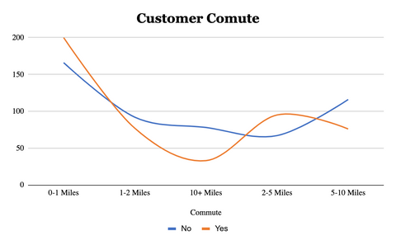
• Customer Commute Pattern (LineChart)
Insight:
The majority of bike buyers have short daily commutes
Customers commuting 0–1 Miles and 2–5 Miles represent the largest share of bike purchases.
Very few buyers commute more than 10 miles daily.
Business Takeaway:
Bikes are primarily being used for short-distance, urban commutes.
Marketing should highlight ease, cost-efficiency, and time-saving benefits for short commutes.
Explore offering compact, lightweight models targeted at city commuters.

Slide 5
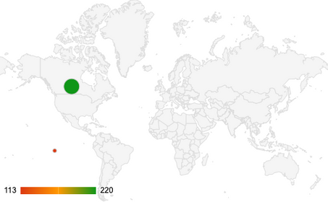
"Bike Buyers by Region – North America Leads the Market"
Insight:
North America leads with the highest number of bike buyers at 220, accounting for nearly 46% of total purchases.
Europe follows with 148 buyers (~31%).
Pacific has the lowest buyer count at 113 (~23%).
Business Takeaway:
North America is your strongest market — this region is ideal for launching premium models, loyalty programs, or regional campaigns.
Europe also shows significant potential and can be explored for urban commute solutions.
The Pacific region may benefit from targeted awareness marketing, affordability programs, or understanding local customer needs.

Slide 6
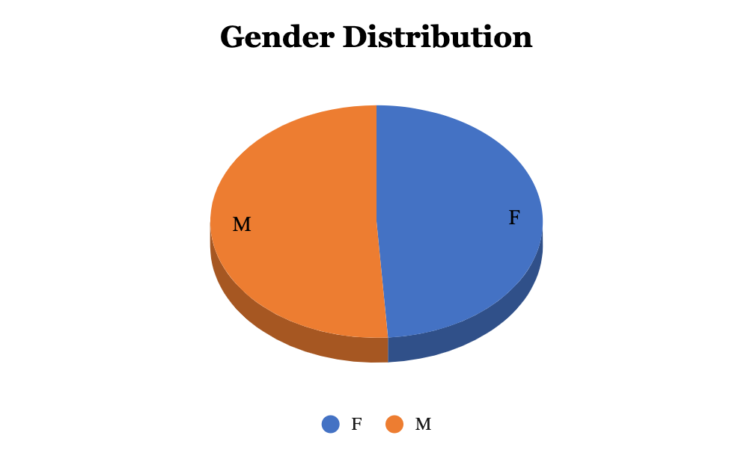
Gender Distribution
Insight:
Shows the percentage of male and female customers.
The data indicates that a higher proportion of bike buyers are male compared to female.
Business Takeaway:
Marketing campaigns can be tailored more toward male demographics, but there’s also potential to explore strategies to engage more female customers.

Slide 7
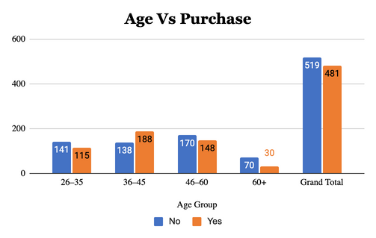
Age vs Purchase
Insight:
Shows the relationship between age groups and the likelihood of purchasing a bike.
The 30–45 age range shows the highest purchase activity.
Business Takeaway:
This age group is likely the most financially stable and active—ideal target for promotions or loyalty programs.

Slide 8
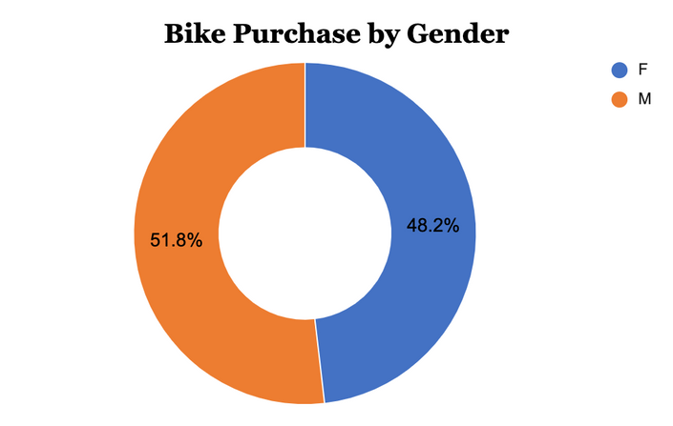
Insight:
Compares how many males vs females actually purchased a bike.
Males not only form the larger customer base but also have a higher purchase conversion rate.
Business Takeaway:
Males are the dominant buyers; however, analyzing what discourages purchases in females may open untapped segments.

Slide 9
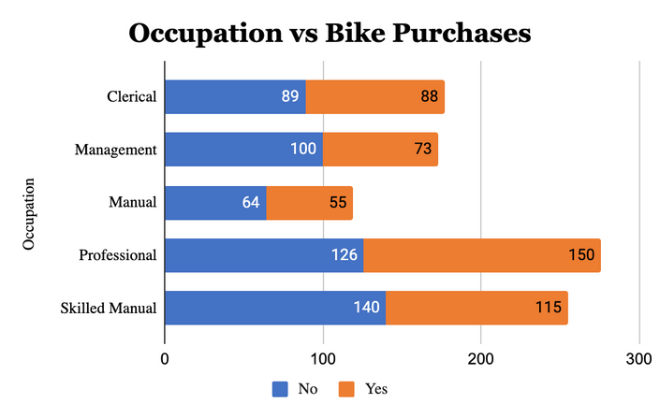
Insight:
Displays which occupational groups are more likely to purchase a bike.
Professionals and Skilled Manual workers are leading categories in purchases.
Business Takeaway:
Focus marketing efforts on working professionals.
Partnerships with companies or offering commuter bikes may boost sales further.

Slide 10
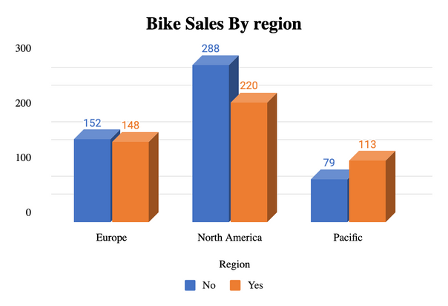
Insight:
North America and Europe dominate sales.
Regional data shows where bikes are most in demand geographically.
Business Takeaway:
These high-performing regions can be leveraged for future launches.
For lower-performing areas, investigate barriers like pricing, infrastructure, or interest.

Slide 11
THANK YOU

